Slide 1

Intermediate PyTorch
©CounterFactual.AI LLC. All rights reserved. Do not distribute.

Slide 2
Agenda
 | Sequence Models Recurrent Neural Networks

Slide 3
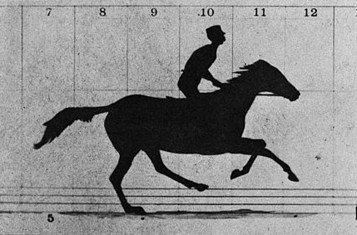
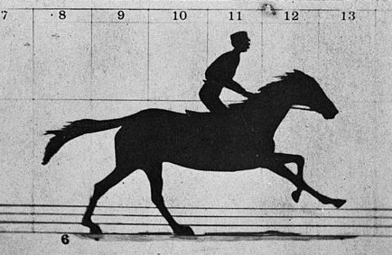
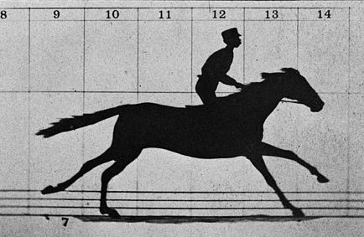
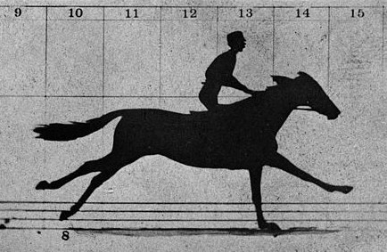
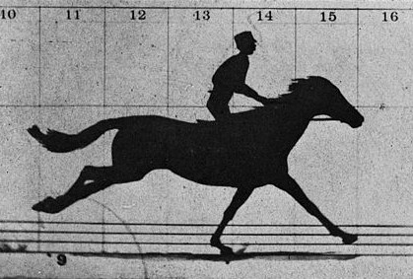
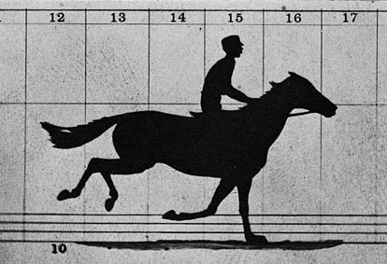
Sequences
Collections of elements where:
Order matters
Variable (potentially inﬁnite) length
Elements can be repeated

Slide 4
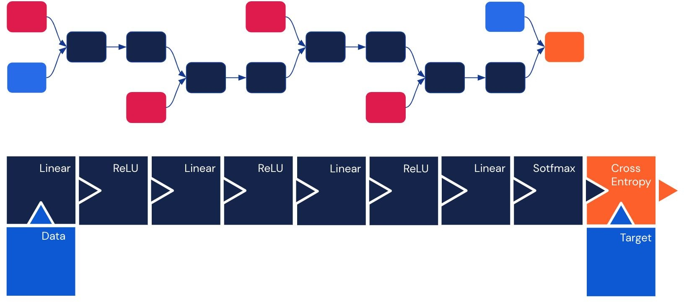
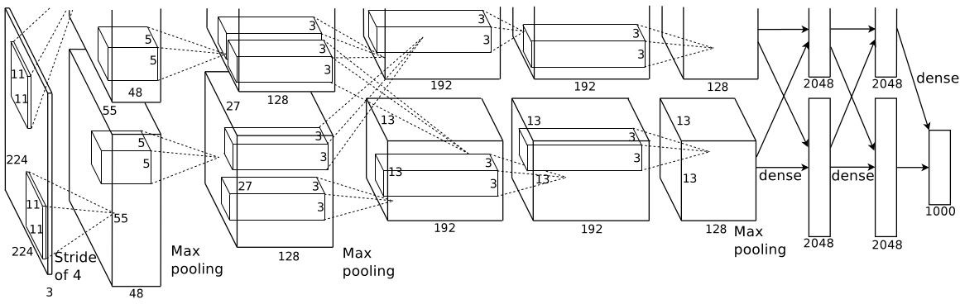
So far…
Models discussed so far don’t excel with sequential data
Feed forward networks
Convolutional networks

Slide 5
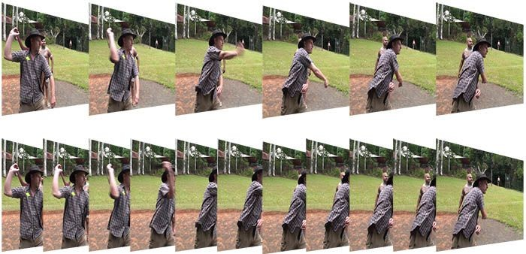
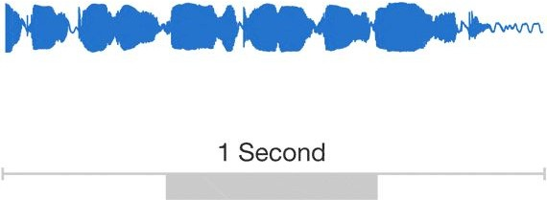
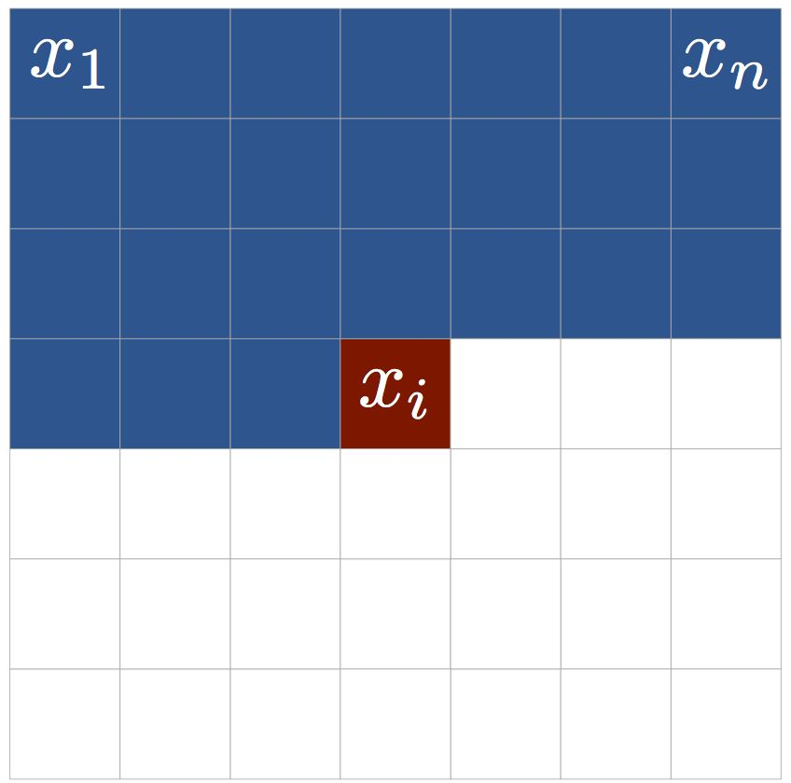
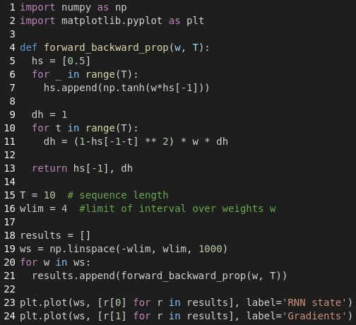
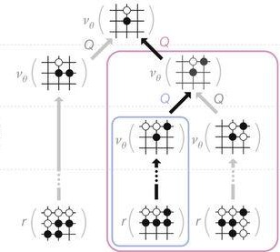
Sequences are everywhere
“Sequences really seem to be everywhere! We should learn how to model them. What is the best way to do that? Stay tuned!”
Words, letters
Speech
Videos
Images
Programs
Decision making

Slide 6
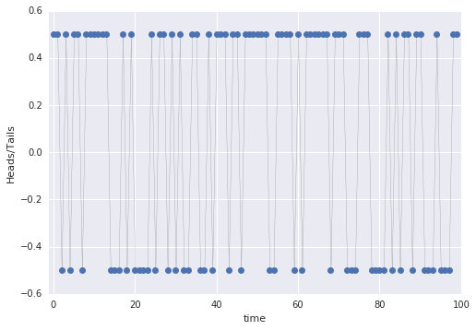
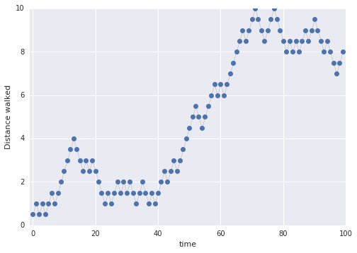
Not all time series are sequences
Heads or Tails?
Random walk down Coin Street
Notes:
But be careful … not all time series values are sequences.
What makes something a sequence is that in a sequence, order matters.
In the coin flip example, the order doesn’t matter. Predicting the value of heads/tails is independent of order.
In the distance walked example (the idea is that you take one step forwards if it’s heads, and one step backwards if it is tails), the distance walked at time=t depends totally and completely on order. Any resemblance to a stock market chart is entirely coincidental.
The slide refers to https://en.wikipedia.org/wiki/A_Random_Walk_Down_Wall_Street

Slide 7
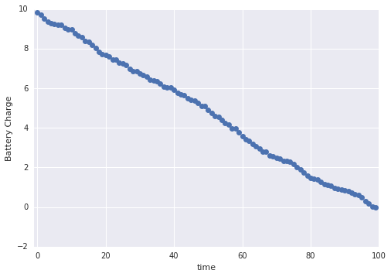
In some cases, the measurement itself leads to actions
Predictive maintenance
Notes:
Simulated data by author

Slide 8
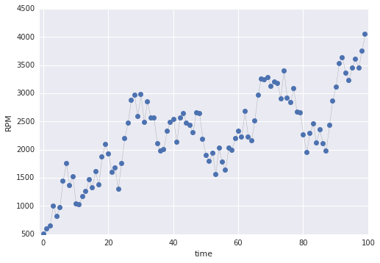
The measurements might be proxies for things we care about
IoT sensor data

Slide 9
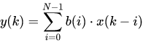
Convolution looks at only the last few samples of the sequence
x₀
x_{k-1}
Finite impulse response (FIR) filter is a CNN in disguise
Notes:
https://en.wikibooks.org/wiki/Signal_Processing/Digital_Filters#ARMA_Filters for analogy to traditional time-series methods
Take windows of the sequence and train a linear combination of the window to predict the output -- FIR filters (like a CNN)

Slide 10
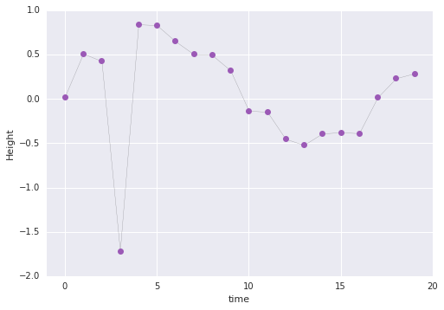
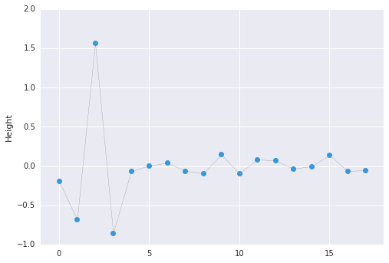
Convolution also works in one dimension; here, for example, is an anomaly-finding filter
pt.conv1d(src, filter, padding=‘same’)
Notes:
This, for example, is an edge filter in image processing; in time series, you can use it to find anomalies
See how the slow change in [10,15] isn’t picked up by the filter.
This works because it find this specific order -- a sharp decrease ...

Slide 11
Convolving a 1D sequence typically involves five steps
Flatten the input sequence
Use conv1d to apply a number of filters to the sequence
Use max_pooling1d to add some spatial invariance and downscaling
Flatten the resulting output into a sequence
Send it through a fully connected layer with the appropriate output node

Slide 12
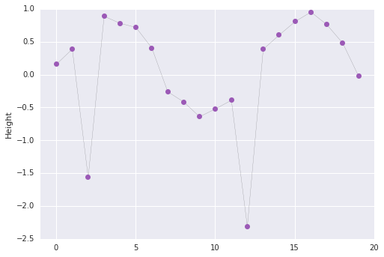
Because CNNs are match filters, they have difficulty with variable-length dependencies

Slide 13
When short-term memory is sufficient CNNs work well
Don’t overcomplicate things -- if you can use CNNs, use them.
RNNs are up next but they can be harder to train
CNNs are simpler, and often work quite well

Slide 14
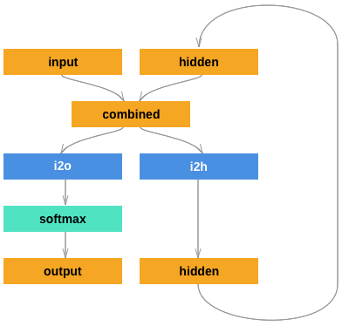
RNNs maintain an internal (hidden) state that is updated each time a new input is encountered
i2h = nn.Linear(input_size + hidden_size,
hidden_size)
i2o = nn.Linear(input_size + hidden_size, output_size)
softmax = nn.LogSoftmax(dim = 1)
def forward(self, input, hidden):
combined = torch.cat((input, hidden), 1)
hidden = i2h(combined)
output = i2o(combined)
output = softmax(output)
return output, hidden
The hyperparameter hidden_size is the number of parameters in the hidden state.

Slide 15
Training an RNN cell is like unrolling it across time steps
X₀
X₁
X₂
X₃
X₄
X₅
H₋₁
H₀
H₁
H₂
H₃
H₄
H₅
cell
cell
cell
cell
cell
cell
Y₀
Y₁
Y₂
Y₃
Y₄
Y₅
The same weights and biases are shared and updated in the training loop (across iterations)
Notes:
To train an RNN cell, you must unroll it across time. Why ?
There is only one cell -- even though we show it being unrolled, it’s really just one set of weights & biases.
Consider a single cell. Put something on its inputs. Its input state is the state received from the previous iteration.
This gives you some outputs. Not happy with what you got ?
Fine, compute the difference between what you got and your desired outputs, from that compute a gradient, and retro-propagate.
This will adjust weights and biases in the internal neural network layers so as to make the difference smaller.
But wait, what if the problem was not in the weights and biases at all ? What if the problem was the input state you received from the previous iteration ?
No luck in that case. That state has already been computed, you cannot go back in time to try and recompute it using better weights and biases, or can you ?
Actually, you can, up to a certain point. The trick to training RNNs is to unroll a the network across n iterations, by replicating one RNN cell. The first input state is still a constant as far as this training step is concerned. However, all of the following states are now combinations of weights, biases and inputs, amenable to backpropagation.
2 takeaways:
An RNN cell is a state machine and can therefore represent state changes across many many steps (for example close a parenthesis that was opened 5000 step ago)
However, to train an RNN, it has to be unrolled across a finite number of steps (usually less than 100). If there are state changes you want to teach it (like opening and closing parentheses) they must appear in the training dataset across spans of no more than N time steps, N being the number of unrolled steps.

Slide 16
You can layer RNN cells and treat them as one cell
X₀
X₁
X₂
X₃
X₄
X₅
0
H₀
H₁
H₂
H₃
H₄
H₅
cell
cell
cell
cell
cell
cell
0
H’₀
H’₁
H’₂
H’₃
H’₄
H’₅
cell
cell
cell
cell
cell
cell
Y₀
Y₁
Y₂
Y₃
Y₃
Y₅
The number of layers is a hyperparameter

Slide 17
Demo: Sequence Classification

Slide 18
Agenda
 | Transformers

Slide 19
Long term dependencies are important
… Finally, Tim was planning to visit France on the ﬁnal week of his journey. He was quite excited to try the local delicacies and had lots of recommendations for good restaurants and exhibitions. His ﬁrst stop was, of course, the capital where he would meet his long-time Friend Jean-Pierre. In order to arrive for breakfast he took the early 5 AM train from London to ...

Slide 20
Long term dependencies are important (continued)
… Finally, Tim was planning to visit France on the ﬁnal week of his journey. He was quite excited to try the local delicacies and had lots of recommendations for good restaurants and exhibitions. His ﬁrst stop was, of course, the capital where he would meet his long-time Friend Jean-Pierre. In order to arrive for breakfast he took the early 5 AM train from London to ...

Slide 21
Long term dependencies are important (continued)
… Finally, Tim was planning to visit France on the ﬁnal week of his journey. He was quite excited to try the local delicacies and had lots of recommendations for good restaurants and exhibitions. His ﬁrst stop was, of course, the capital where he would meet his long-time Friend Jean-Pierre. In order to arrive for breakfast he took the early 5 AM train from London to ...
PARIS!

Slide 22
RNNs Key Takeaways
RNNs can model sequences of variable length and can be trained via backpropagation
However, RNNs suffer from the vanishing gradients problem, which stops them from capturing long-term dependencies
RNN can only learn dependencies in data up to its unrolled length
during inference, it can represent state changes over longer sequences
Your training example must be long enough to contain the long-term dependency

Slide 23
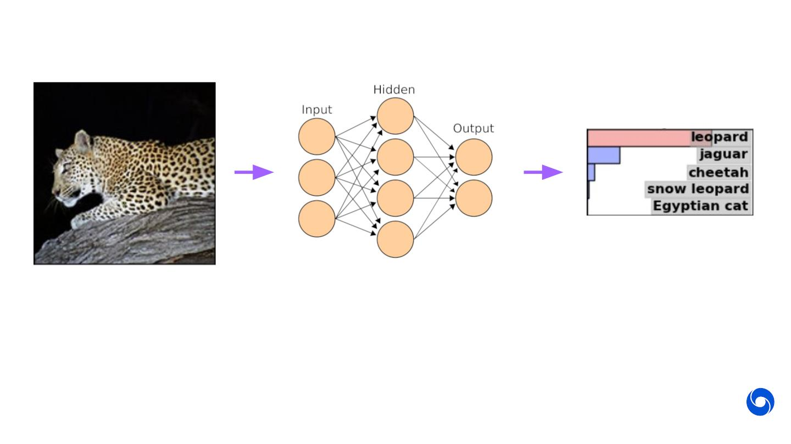
What does deep learning have to do with attention?
Neural networks learn a form of implicit attention where they respond more strongly to some parts of the data than others.

Slide 24
Explicit Attention
Implicit attention is great, but there are still advantages to an explicit attention mechanism that limits the data presented to the network in some way:
Computational efﬁciency
Scalability
For example, ﬁxed sized glimpse for any size image
Sequential processing of static data
For example, moving gaze
Easier to interpret

Slide 25
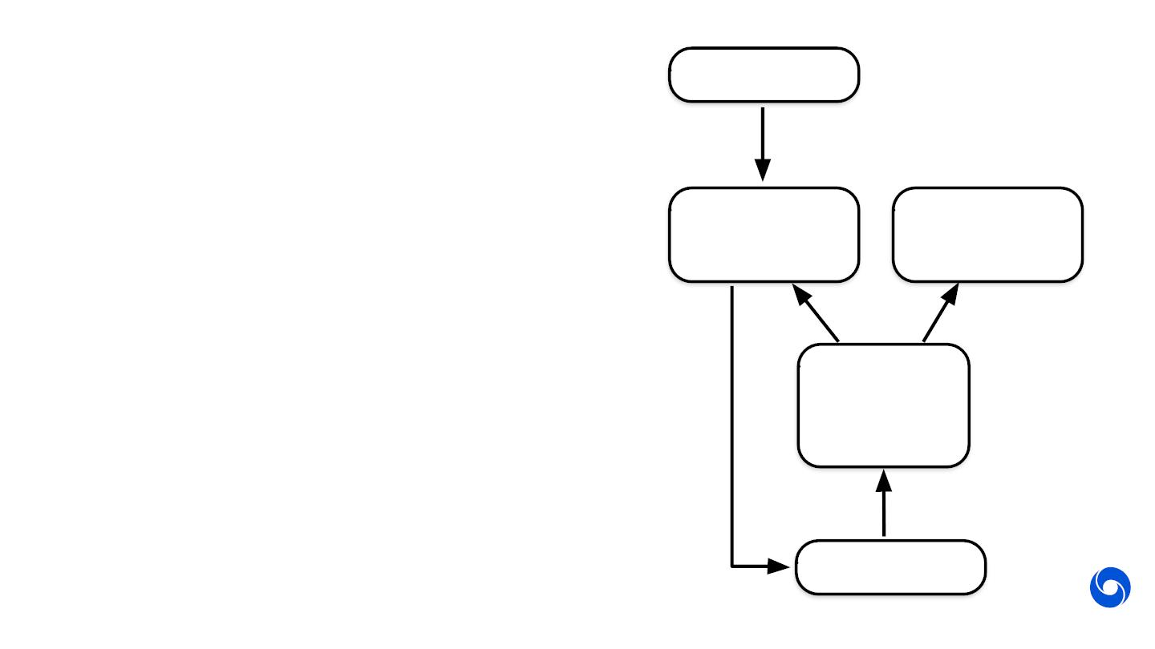
Explicit Neural Attention
Data
The network produces and extra output tensor used as a parameter to an attention model
The attention model then operates on some data (image, audio sample, text to be translated…) to create a ﬁxed-size “glimpse” tensor that is passed to the network as input at the next time step
The entire model is recurrent, even if the network isn’t
Attention
Model
Output
Network
Glimpse

Slide 26
Transformers: Attention for Sequences
Convolution
Transformer
Transformer networks take attention to its logical extreme: get rid of everything else (RNN hidden state, convolutions) and just use attention to repeatedly transform the entire input sequence

Slide 27
Transformers: Attention for Sequences (continued)
Convolution
Transformer

Slide 28
Transformers: Attention for Sequences (continued)
Convolution
Transformer

Slide 29
Transformers: Attention for Sequences (continued)
Convolution
Transformer

Slide 30
Agenda
 | Anomaly Detection Autoencoders

Slide 31
What is an anomaly detection
Anomalies or outliers are data points within the datasets that appear to deviate markedly from expected outputs.
An outlier is an observation which deviates so much from the other observations as to arouse suspicions that it was generated by a different mechanism.
Anomaly detection refers to the problem of finding patterns in data that don’t confirm to expected behavior

Slide 32
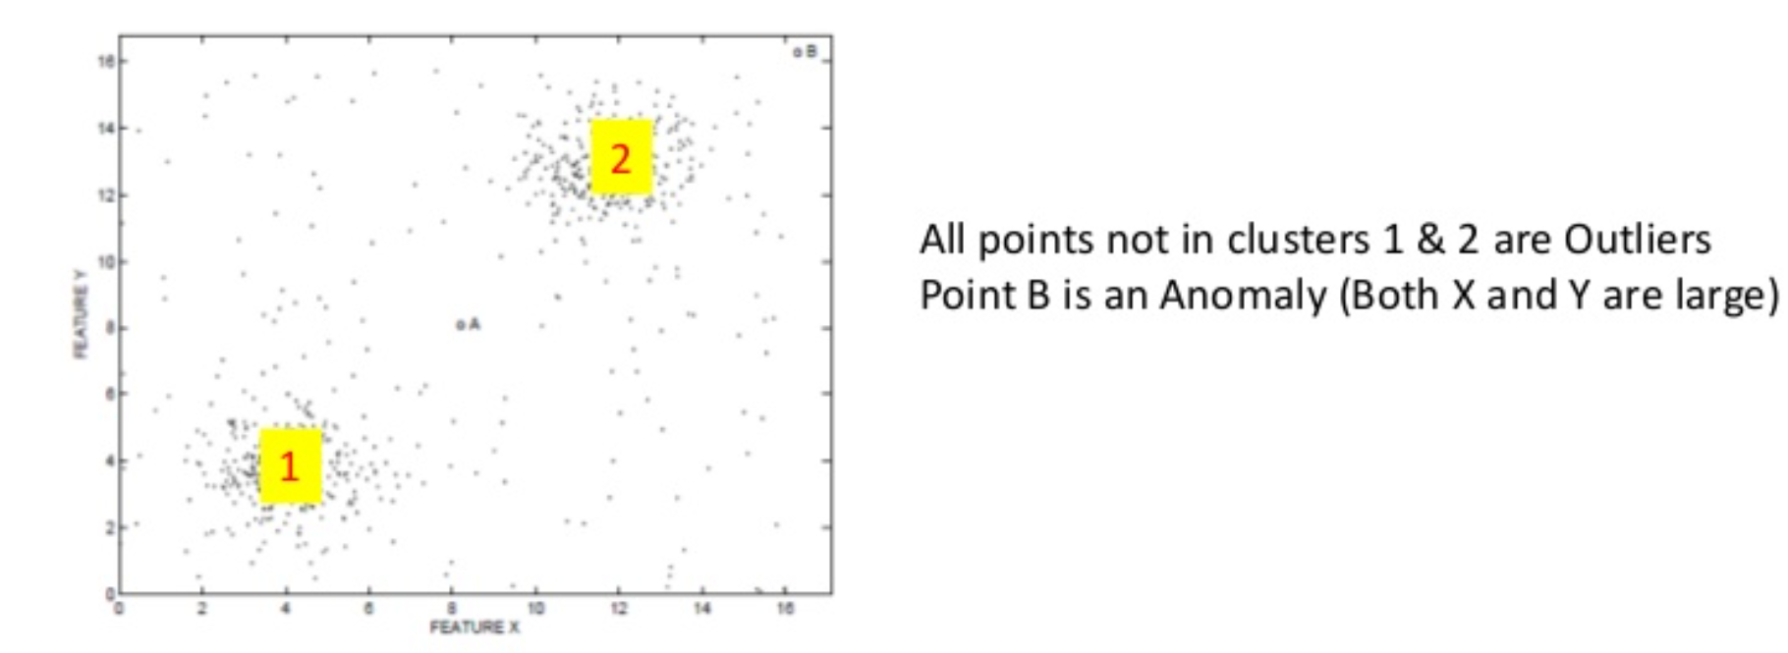
Anomaly vs. outliers
Outliers: data points that are considered out of the ordinary or abnormal. This includes noise.
Anomalies: a special kind of outlier that has significant/critical/actionable information which could be of interest to analysts.
B

Slide 33
Outliers
Human judgement determines what is considered an outlier or an anomaly
Most outlier detection methods generate an output that are:
Real-valued outlier scores: quantifies the tendency of a data point being an outlier by assigning a score or probability to it.
Binary labels: result of using a threshold to convert outlier scores to binary labels, inlier or outlier.

Slide 34
Applications of anomaly detection
Credit card fraud detection
Medical malpractice
Insider trading detection
Heat, fire sensors
E-commerce pricing issues
Intrusion detection
Medical anomalies
Novel topics, events

Slide 35
Aspects of anomaly detection problems
Importance of a defining what is normal
Challenges when dealing with Anomaly Detection problems
Input Data Characteristics
Anomaly Classification
Outputs of Anomaly Detection
Techniques used for Anomaly Detection
Performance evaluation

Slide 36
Determining the “normal” model
We could assume that the points may come from a statistical distribution. For example, from a Gaussian distribution
We could use an algorithm like k-nearest neighbor to define points that are close and identify outliers that are at a large distance from most of the points
We could use a clustering algorithm to assign membership to clusters

Slide 37
Importance of a defining what is normal
We will illustrate once more why the choice of the “normal” model is important.
We said earlier that the “outlierness” can be quantified as a score.
One popular score is Z-score.
A z-score can be calculated from the following formula. z = (X – μ)/σ
Where z is the z-score, X is the value of element, μ is the population mean, and σ is the standard deviation.
It computes the number of standard deviations by which the data varies from the mean and used as a proxy to determine outliers.
However, this works only if the data is from a Gaussian distribution.

Slide 38
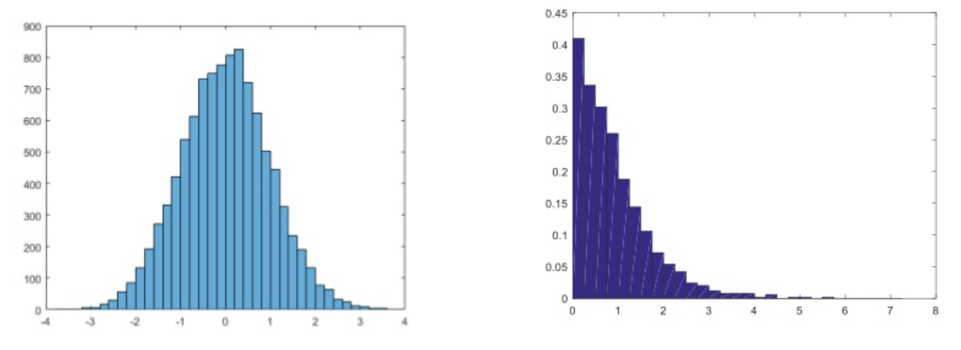
Importance of a defining what is normal
In the first case, 99.9% of the data is within the 3a limits. The Z-score test works well here to detect outliers.
In the second case, the distribution isn’t normal and is from a Zipf distribution. Here a Z-score test isn’t valid

Slide 39
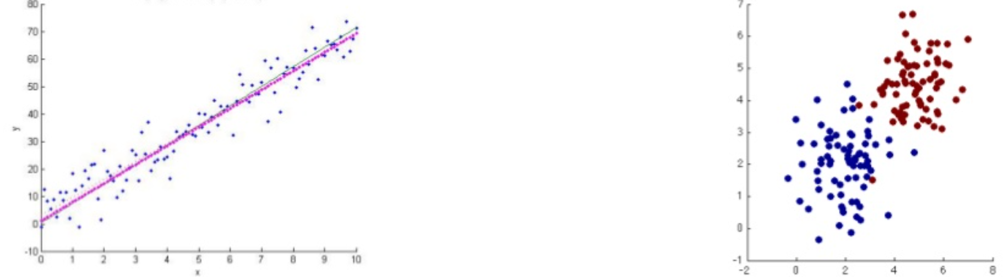
Importance of a defining what is normal
It is important for the analyst choose the right representation for the normal model.
In the first case, clustering is useless but a Linear regression is a good representation.
In the second case, Clustering is more appropriate.

Slide 40
Challenges when dealing with anomaly detection problems
The evolving “normal behavior” in data
Example:
$40 + credit card transactions for a student – Average 5 per month
$40 + credit card transactions for a professional – Average 15 per month
Data and application dependency
For AAPL, a +/- $5 fluctuation in a day is an anomaly.
For a risky stock, up to +/- $10 fluctuation may be normal and $15 fluctuation might be an anomaly.
Lack of labeled data makes it harder to detect anomalies
Not being able to distinguish noise

Slide 41
Anomaly classification
Anomalies can be classified into three major categories
Point Anomalies
In an instance is anomalous compared with the rest of instances, the anomaly is considered as point anomaly.
Contextual Anomalies
If an instance is anomalous in a specific context, the anomaly would be considered as a contextual anomaly.
Collective Anomalies
If a collection of related data records are anomalous with respect to the entire data set, the anomaly is a collective anomaly.

Slide 42
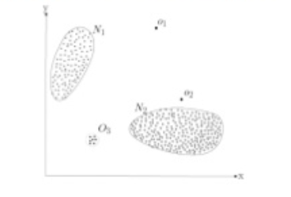
Point anomalies
In the figure, points o1 and o2 are considered point anomalies.
O1
O2
Examples:
A 50% increase in daily stock price.
A credit card transaction attempt for $5000 (assuming you have never had a single transaction for anything above $1000)

Slide 43
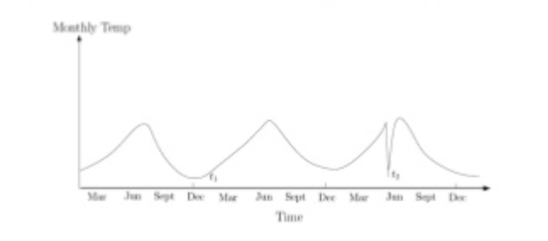
Contextual anomalies
In the figure, temperature t2 is an anomaly.
T2
Note that t1 is lower than t2 but contextually, t1 is expected and t2 isn’t when compared to records around it.

Slide 44

Collective anomalies
Multiple buy stock transactions and then a sequence of Sell transactions around an earnings release date may be anomalous and may indicate insider trading.
Consider the sequence of network activities recorded

Slide 45
Anomaly Detection techniques
Classification
Extreme value analysis
Statistical
i. Parametric techniques
a. Gaussian model-based models.
b. Regression-based models
c. Mixture models
ii. Non-parametric techniques
a. Histogram-based models
b. Kernel-based models.
Proximity-based models
i. Cluster analysis
ii. Nearest neighbor analysis
Information theoretic models
Meta-algorithms and ensembles
i. Sequential ensembles
ii. Independent ensembles.

Slide 46
1. Extreme value analysis
Assumption: Anomalies are extreme values in the data set.
Goal: Determine the statistical tails of the underlying distribution
Data: Univariate cross-sectional data
Examples:
Z-score test for a dataset which is assumed to be normal
Grubb’s test
Using Box-plots to detect anomalies.

Slide 47
2. Classification
Assumption: Available labeled data
Goal : Build a classifier that can distinguish between normal and anomalous data
Data : Multi-dimensional cross-sectional data (Numeric/categorical)
Examples:
Rule-based (Decision trees)
Neural Networks
SVM

Slide 48
3. Statistical
Statistical techniques fit a statistical model to a given data and applies a statistical inference test to determine if an unseen instance belongs to this model or not
Based on the assumed statistical model that describes the data, anomalies are data points that are assumed to have not been generated by the model.

Slide 49
3. Statistical
Assumption: the underlying distribution is known and the parameters for the distribution can be estimated.
Goal: Infer if a data point belongs to the distribution or not.
Data : Depends on the technique
Techniques:
Gaussian techniques
IQR test (Box plots)
The region between Q-1.5*OR and Q+1.5*QR contains 99.3% of observations, and hence the choice of the 1.5lQR boundary makes the box plot rule equivalent to the 3a technique for Gaussian data.
Grubb’s test
Chi-squared test

Slide 50
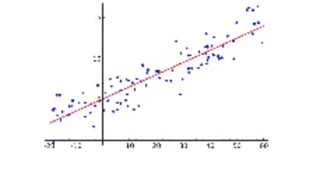
3. Statistical (Parametric)
Regression based techniques
model the data into a lower dimensional sub-space using linear correlations.
i.e. summarize data in to a model parameterized by the coefficients and constant.
Step 1: Build a regression model with various features
Step 2: Review residuals, the magnitude of the residuals indicate anomalies.

Slide 51
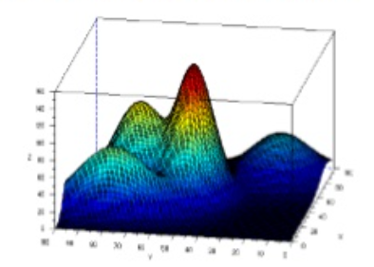
3. Statistical (Parameteric)
Mixture models
Example: Gaussian mixture model
Here, the data is characterized by a process that is a mixture of Gaussian clusters
The parameters are estimated using an EM algorithm.
The goal is to determine the probability of data points being in different clusters.
Anomalies would have low probability values.

Slide 52
3. Statistical (Non Parameteric)
Assumption : The data’s distribution isn’t known apriori
Goal : Infer if a data point belongs to the assumed normal model
Data : Depends on the technique
Technique:
Histogram
Count/Frequency based: Create histogram, Bings with very few points indicate anomalies
Kernel-based : Using density-estimation techniques, build kernel functions and estimate probability-distribution function(pdf) for normal instances. Instances lying in the low-probability areas termed anomalies.

Slide 53
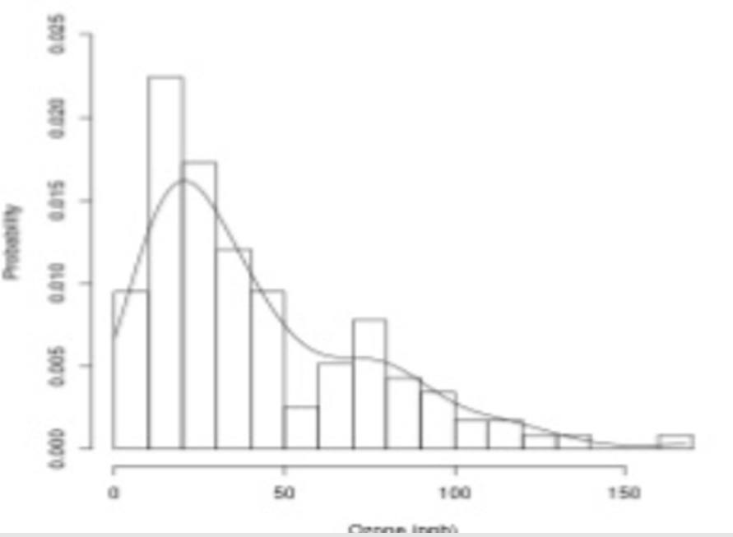

Example: Histogram of ozone pollution with kernel density plot

Slide 54
4 Proximity-based
Assumption : Anomalous points are isolated from the rest of the data
Goal: Segment the points/space with a goal of identifying anomalies.
Data : Typically, multi-dimensional cross-sectional data
Methods:
Clustering : unsupervised techniques to group data into clusters using distances/densities depending on the technique. Anomalies belong to sparse clusters/ no clusters and are typically far off from “normal” clusters. Examples: K-means.

Slide 55
5 Meta-algorithms and sequential
Assumption : Using multiple algorithms would help increase the robustness of the anomaly detection algorithm.
Goal : Use ensembles to enhance the quality of anomaly detection
Data : Typically, multi-dimensional cross-sectional data
Methods:
Sequential ensembles: A given algorithm or a sequence of algorithms are applied sequentially. Example: Boosting methods for classification
Independent ensembles : Different algorithms or different instances of the same algorithm are run and results combined to detect robust outliers.

Slide 56
Five methodologies to anomaly detection
Graphical approach
Statistical approach
Machine learning approach
Density based approach
Time series approach

Slide 57
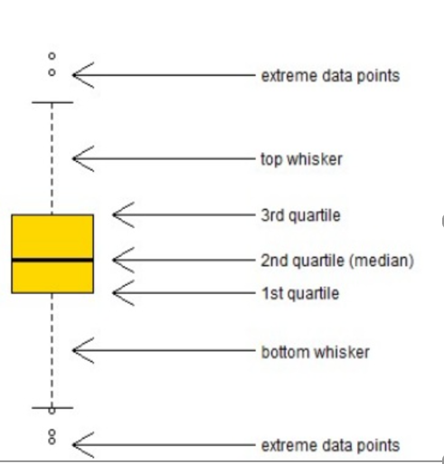
Box plot
A standardized way of displaying the variation of data based on the five number summary, which includes minimum, first quartile, median, third quartile, and maximum.
This plot does not make any assumptions of the underlying statistical distribution.
Any data not included between the minimum and maximum are considered as an outlier

Slide 58
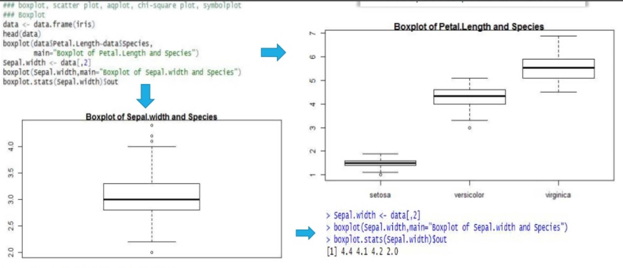

Slide 59
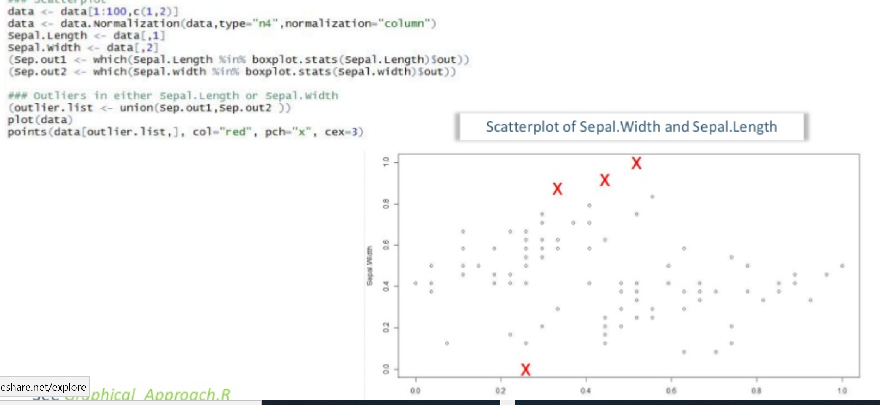
Scatter plot

Slide 60
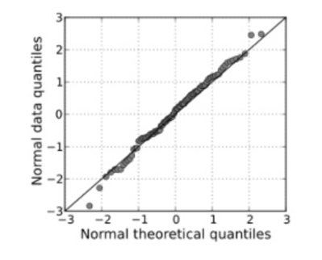
Q-Q plot
In statistics, a Q-Q plot is a probability plot, which is a graphical method for comparing two probability distributions by plotting their quantiles against each other
If the two distributions being compared are similar, the points in the Q-Q plot will approximately lie on the line v = x.

Slide 61
Hypothesis testing
This method draws conclusions about a sample point by testing whether it comes from the same distribution as the training data.
Statistical tests, such as the t-test and ANOVA table, can be used on multiple subsets of the data.
Here, the level of significance, i.e., the probability of incorrectly rejecting the true null hypothesis, needs to be chosen.

Slide 62
Chi-square test
Chi-square test performs a simple test for detecting outliers of univariate data based on Chi-square distribution of squared difference between data and sample mean.
In this test, sample variance counts as the estimator of the population variance.
Chi-square test helps us identify the lowest and highest values, since outliers can exist in both tails of the data.

Slide 63
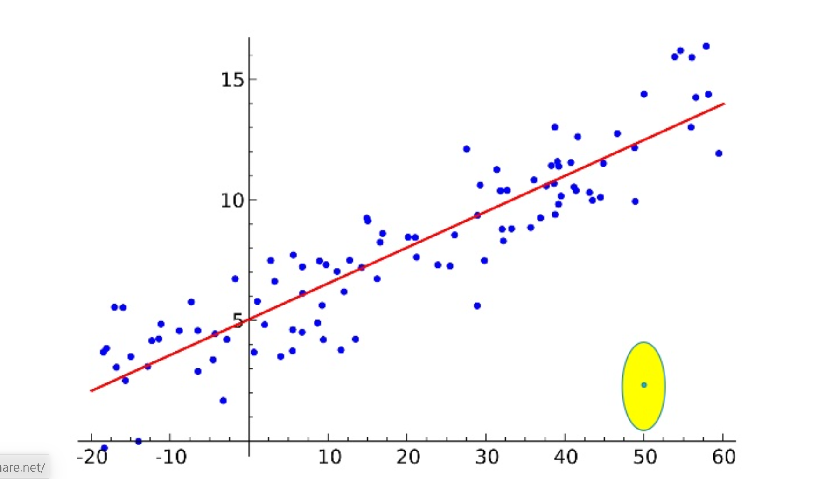
Linear regression

Slide 64
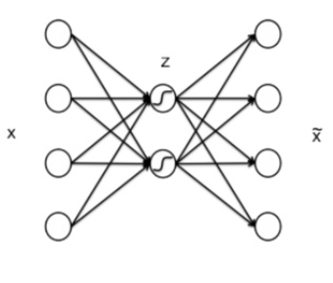
Autoencoder
Goal is to have x’ to approximate x
Interesting applications such as
- Data compression
- Visualization
- Pre-train neural networks

Slide 65
Principal component analysis
Principal component analysis (PCA) is a statistical procedure that uses an orthogonal transformation convert a set of observations of possibly correlated variables (entitles each of which takes on various numerical values) into a set of values of linearly uncorrelated variables called principal components.
In outlier analysis, we do principal component analysis and compute p-values to test for outliers

Slide 66
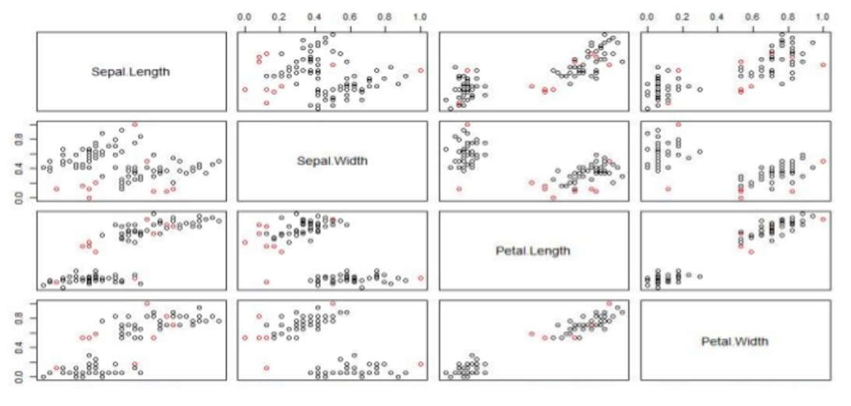
Scatter plots of normal and outlier data points

Slide 67
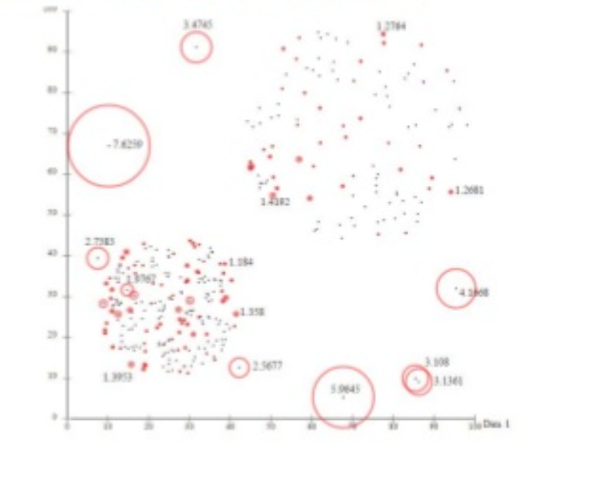
Density based clustering

Slide 68
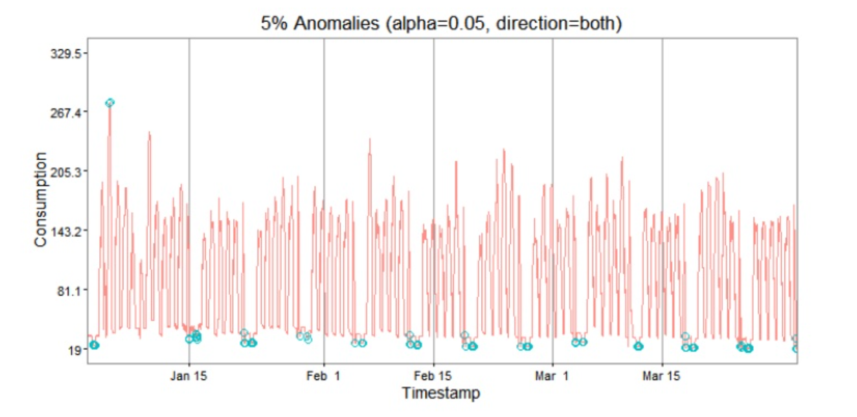
temporal

